Slide 1


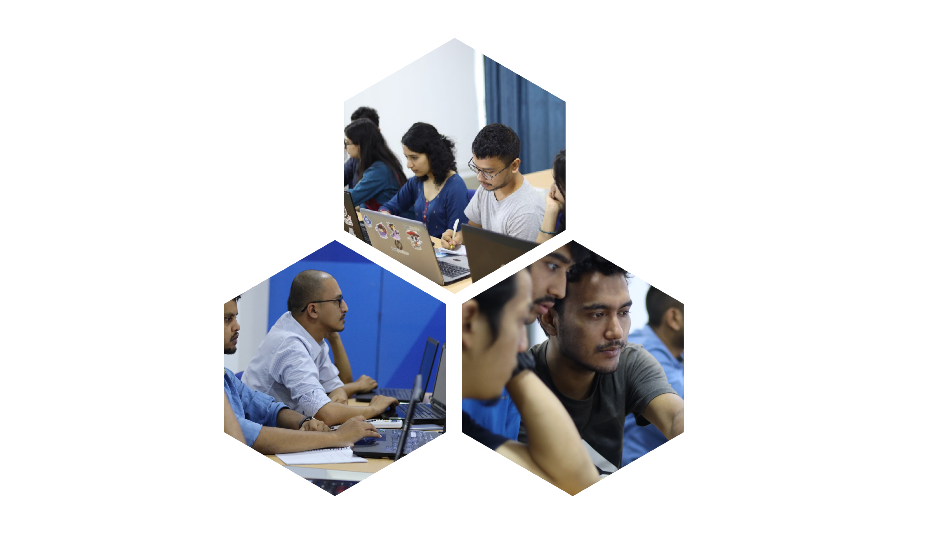

Microdegree in Artificial Intelligence
aifellowship@fusemachines.com | www.fusemachines.com

Slide 2











Why AI?
Importance of AI in present World
Increase Efficiency
Revolutionize Industries
Data Driven Decision making
Improving Daily Life
Notes:
Grammarly: Enhances daily writing.
Uber Eats & DHL: Use AI for quickest route identification.
Mayo Clinic: Leverages AI for patient records and diagnosing eye diseases even cancers.
Siemens: Uses AI for renewable energy and robotic task automation.
Coca-Cola, Amazon & Airbnb: AI for recommendations, dynamic pricing, and warehouse automation.
Netflix & Spotify: AI for personalized movie and music recommendations.

Slide 3
Future in AI
$15.7 Trillion > 2030
97Million > 2025
Notes:
Fun Fact: By 2030, AI will contribute $15.7 trillion to the global economy and create 97 million new jobs by 2025!

Slide 4


DEMOCRATIZE AI
How Fusemachines is Democratizing AI

Slide 5
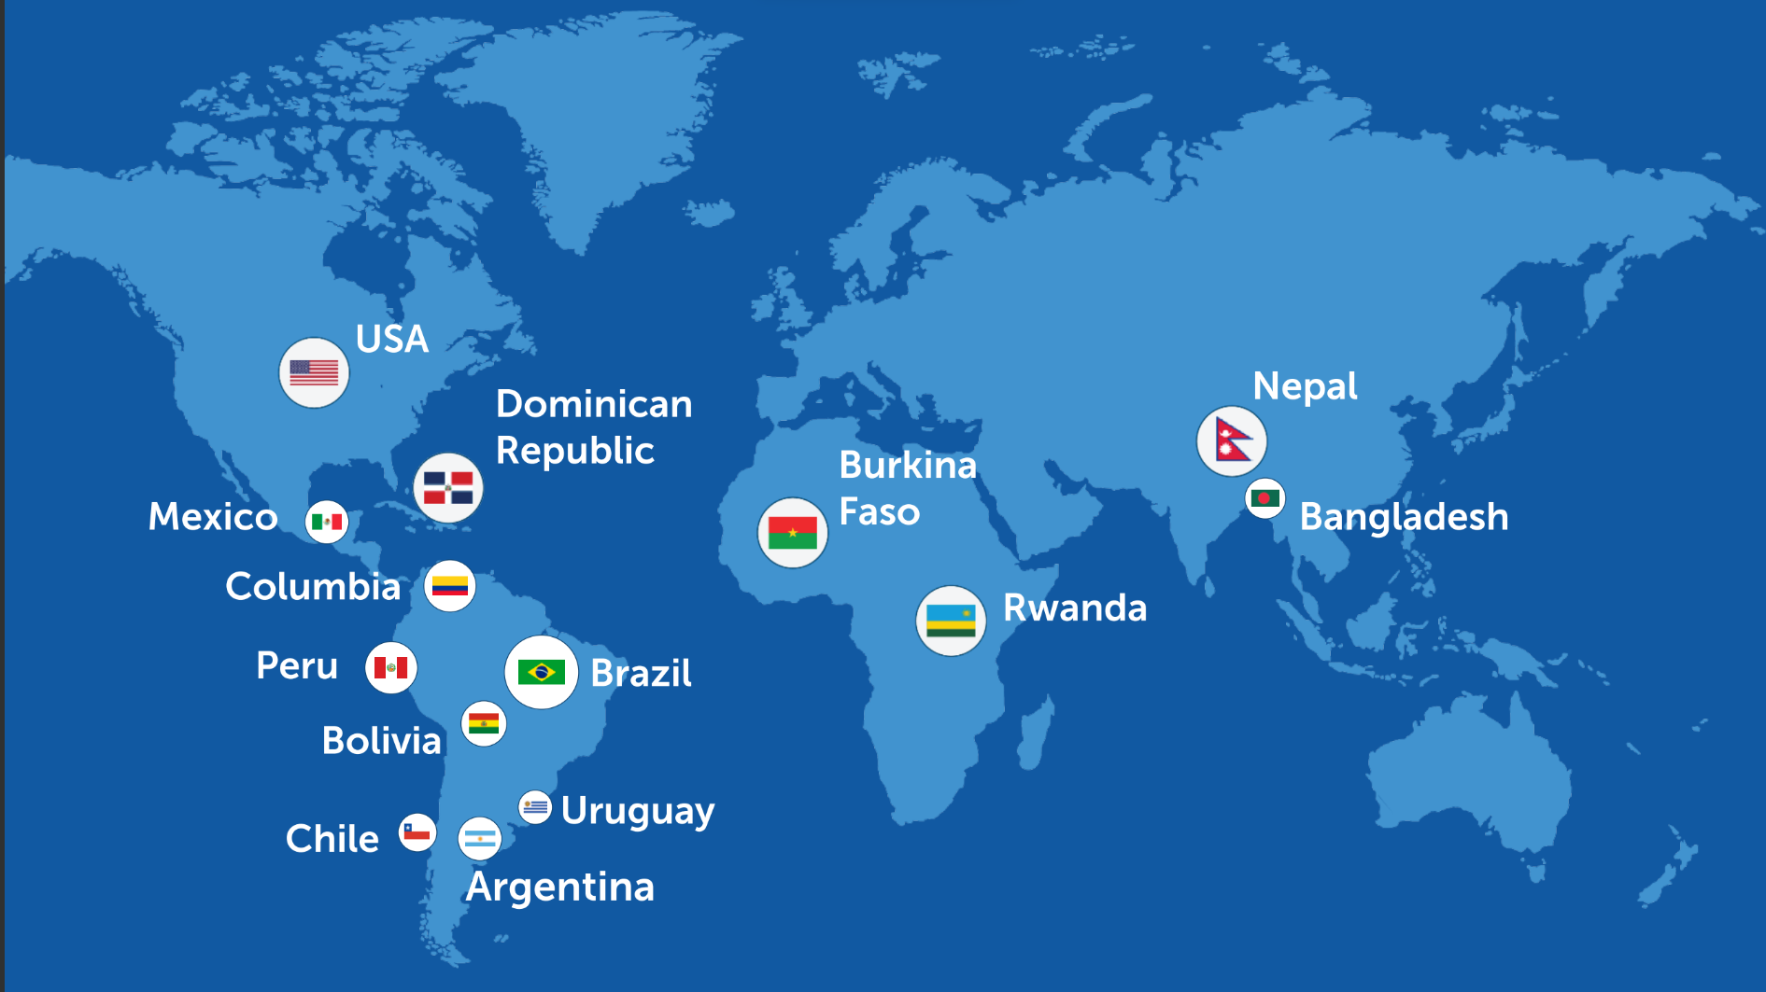
AI EDUCATION
Fusemachines AI Fellows
2017–2024
12000+
Total Applicants
1000+
Total Enrolled
800+
Graduated

Slide 6

Notes:
Through our AI Shikshya for Nepal initiative, we aim to train thousands of AI engineers and impart AI education up to the High School levels. In AI Fellowship 2024 Nepal, 3000 applicants registered.

Slide 7
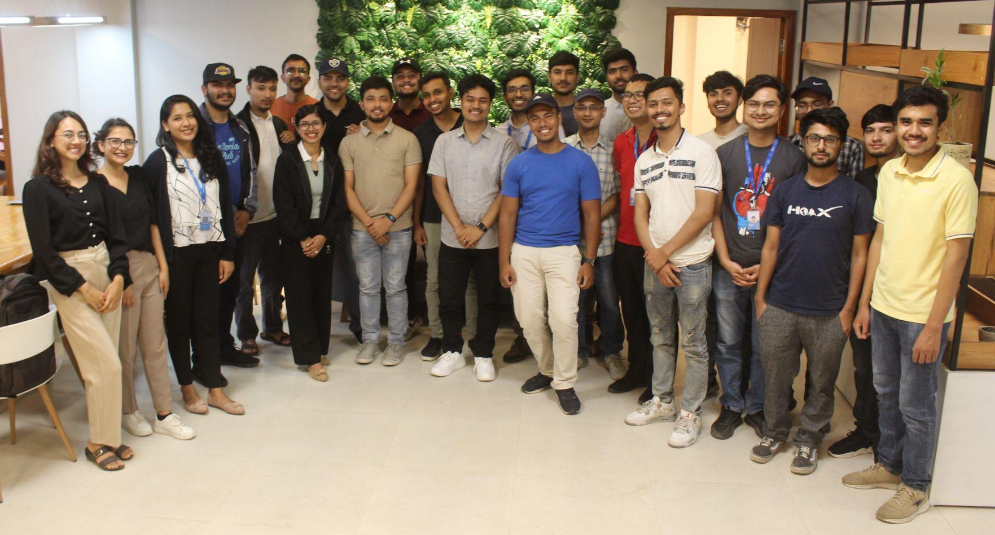





































A Snapshot of where our AI Fellowship Alumni are engaged
Types of roles our alums are engaged in:
Founders/ Entrepreneurs
Data Engineer
Data & Applied Scientist
Sr. ML Engineers
Computer Vision / NLP Specialists
Director of Engineering
Head of AI Services
Sr. Managers (Eng. / Product)

Slide 8
What is the MicrodegreeTM in AI (AI Fellowship)
Prerequisites
Course Duration 6 Months
Lecture: 1 session per week (2hr) Recitations: 1 session per week (2hr) TA 1 Session per week (1hr)
Course Inception: April
Math: Linear Algebra, Probability, Statistics, Calculus
Strong Programming Capability: Python, DSA
Learning Outcome
Gain hands-on experience with data science and ML on real-world problems.
Develop a strong understanding of AI, ML, and Deep Learning algorithms, math, and programming.
Select and implement the right algorithms, libraries, and techniques for diverse problems.
Conduct experiments, evaluate models, and design end-to-end pipelines.

Slide 9
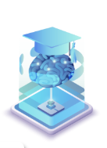
Application Process
TBD
TBD
TBD
TBD
Online application
Online entrance exam
Online interview
Enrollment
Complete and submit form
Receive confirmation email
Sign into our LMS platform
Take one hour aptitude test
Shortlisted candidates are interviewed
Final selection
Enroll and onboard
Start your AI fellowship journey!

Slide 10
Q&A
Any Questions?

Slide 11
Don't just be a user
Dare to be a creator!
Notes:
"We all use technology daily, but the real magic happens when you become the creator, not just the user."
"As a creator, you can shape the future—whether it's through coding, designing AI, or solving real-world problems."
"So, don’t just be a user—dare to be a creator and make your mark on tomorrow!

